Slide 1
House Square Feet Prediction
1
Targeted Audience : Real Estate Developers.
By : Chandu Eddala

Slide 2
2
01
Problem
02
About Data
CONTENTS
03
Features
04
Model Comparisions
05
Demo
06
Conclusion

Slide 3



3
Problem Statement :
The Real Estate Company wanted to Build the the Model which can Predict the Square feet required to build the house and also need to estimate the Total Lot Size
They have the 5000 Houses ,Tuscon location data set and the data set is processed .
Need to build the Simple Model to Estimate the total Lot size required .

Slide 4
4
About Data
1
Continous
3
Bollean
2
Categorical
1.sold_prices
2.cbrt_acres
3.taxes
4.bedrooms
5.bathrooms
6.sqrt_ft
7.garage
8.fireplaces
9.log_Hoa
10.per_sqrt
1.Zipcode
2.year_built
3.range_label
1.Dishwasher
2.freezer
3.refrigerator
4.oven
5.garbage disposal
6.double sink
7.microwave
8.compactor
9.electric range
10.island
11.appliance color
12.gas range
13.prep sink
14.countertops granite
15.desk
16.lazy susan
17.pantry walk-in
18.pantry closet 19.pantry cabinet
20.garbage disposal
21.mexican tile
22.wood
23.natural stone
24.other
25.ceramic tile
26.carpet

Slide 5

The Input Features
5
01
Total Price
Total Amount the Customer willing to Spend on their House
02
Bedrooms
Number of bedrooms.
03
Bathrooms
Number of Bathrooms to have in that House
04
Fireplaces
Number of Fireplaces to have in that House

Slide 6
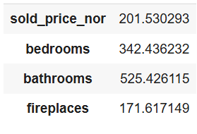
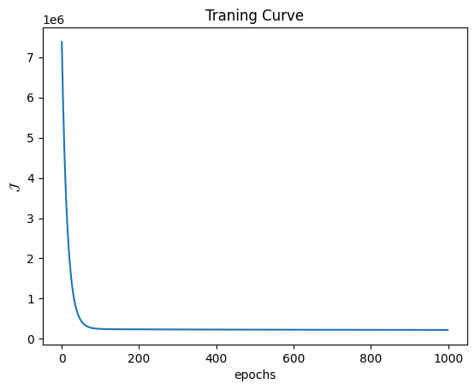
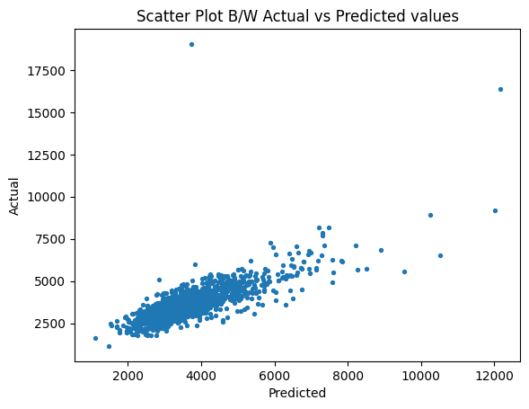
Multivarient Linear Regression
6

Slide 7
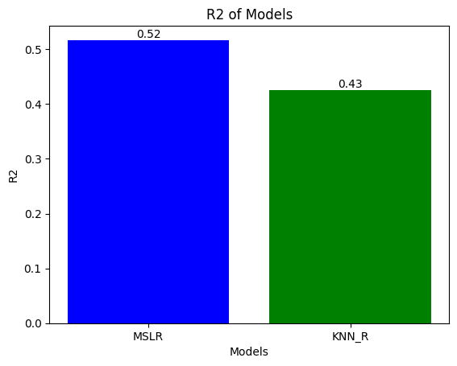
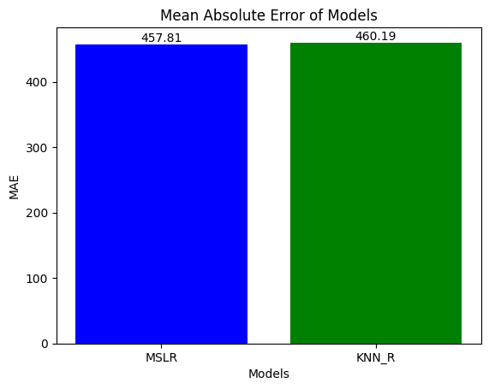
7
The Test R2 & MAE of Models

Slide 8
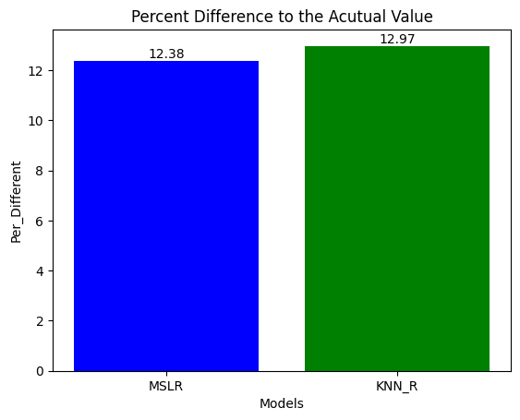
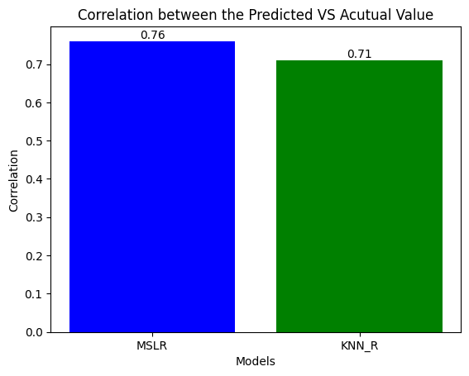
8
The Percentage Different and Correlation.

Slide 9
9
Conclusion :
A
B
We can use the MVLR ,to predict the Sqare feet required to build there dream house including the Lot size (Customize) .
This help to suggest, the right lots to the customers .And also speed-up the desicion .
C
D
With minimum features we are calculating, that’s the best part.So we can add onto online .Stay connected to customers.
Just 5 Varibles are computed so can install into my sytems easily and use it .

Slide 10
THANKS
10
Click here to add the text

